Slide 1

Ahsanullah University of Science & Technology
Department of Computer Science & Engineering
Information System Design & Software Engineering Lab (CSE 3224)

Slide 2
PROJECT Teacher Student Collaboration System
Submitted By
Mahir Rashid : 15-01-04-013
Tasnim Mashrur Mahee : 15-01-04-013
Atiqul Islam Chowdhury : 15-01-04-014
Saiful Somum : 15-01-04-027

Slide 3

WHAT IS ERD ?

Slide 4
Entities:
Which are represented by rectangles. An entity is an object or concept about which you want to store information.
Relationships :
Which are represented by diamond shapes, show how two entities share information in the database.
Attributes :
Which are represented by ovals. A key attribute is the unique, distinguishing characteristic of the entity.

Slide 5
ENTITY SET NAMES
Teacher ( for sharing materials, takes courses, takes attendance)
Courses ( every course info. given to teacher & students)
Materials (provided by teacher & students can download it)
Department ( for dept info.)
Students (for student id & dept. info)
Attendance (for taking attendance of students by different different course teacher)
Quizes ( for adding marks of quiz of every student)

Slide 6
ENTITY ATTRIBUTES
TEACHER
Teacher_name Teacher_id Teacher_cell_no Teacher_mail | Varchar (5000) Varchar (5000) Varchar (5000) Varchar (5000)
STUDENT
Student_name Student_id Student_cell_no Student_mail | Varchar (5000) Varchar (5000) Varchar (5000) Varchar (5000)

Slide 7
ENTITY ATTRIBUTES
COURSES
Course_no Course_name Teacher_id Student_id | Varchar (5000) Varchar (5000) Varchar (5000) Varchar (5000)
DEPARTMENT
Dept_name Teacher_id Student_id | Varchar (5000) Varchar (5000) Varchar (5000)

Slide 8
ENTITY ATTRIBUTES
ATTENDANCE
Teacher_id Student_id Date | Varchar (5000) Varchar (5000) Varchar (5000)
QUIZES
Quiz_no Course_no Marks Student_id | Varchar (5000) Varchar (5000) Varchar (5000) Varchar (5000)

Slide 9
ENTITY ATTRIBUTES
MATERIALS
Material_name Course_no Teacher_id Student_id | Varchar (5000) Varchar (5000) Varchar (5000) Varchar (5000)

Slide 10
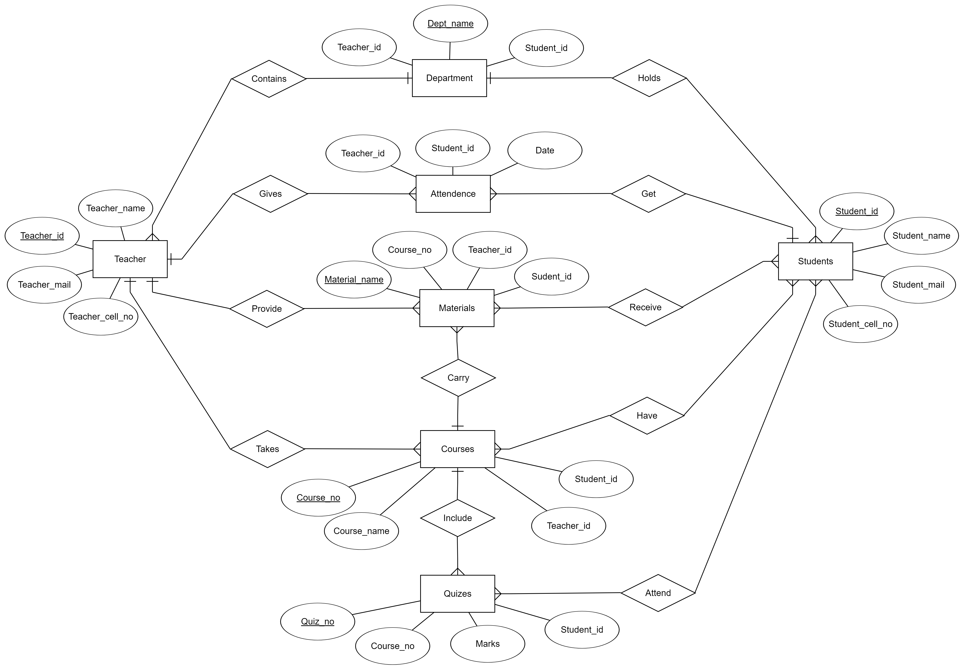
ER DIAGRAM

Slide 11
CONCLUSION
We will try our best to implement the project as the ERD and Class Diagram we have prepared.
Hopefully we can develop a useful, user friendly collaboration system that satisfies the requirements of our client.

